Slide 1
The Battle of Neighborhood
Lingmei Kong

Slide 2
Outlines:
Introduction
Data and Methodology
Results and Discussion
Summary

Slide 3
Introduction
Easy: find a particular store to shop, or restaurants for dinner using various mapping tools
Difficult Problem: Find the most relevant neighborhoods between the two cities
Solution Steps:
Web scrapping the venues and neighborhoods information of the cities
Using clustering method to find neighborhoods clusters
Using statistic correlation to find most similar neighborhoods cluster and thus link the most relevant neighborhoods between two cities

Slide 4
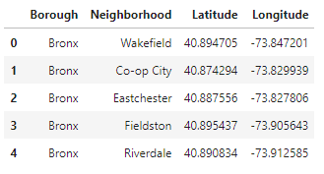
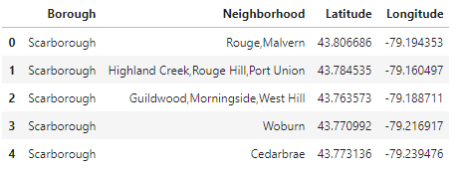
Data and methodology
Data sources:
Neighborhood data for New York tps://cocl.us/new_york_dataset
Neighborhood data for Toronto https://en.wikipedia.org/wiki/List_of_postal_codes_of_Canada:_M.
Venues information from Foursquare
Python Library used: Jason, BeautifulSoup and Request
Snapshot of New York Neighborhood
Snapshot of Toronto Neighborhood

Slide 5
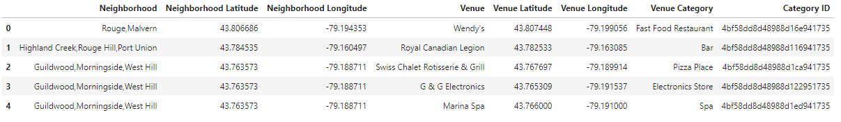
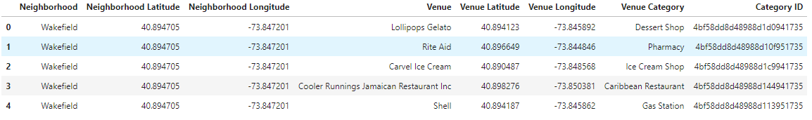
Data and methodology
Snapshot of New York Venues
Snapshot of Toronto Venues

Slide 6
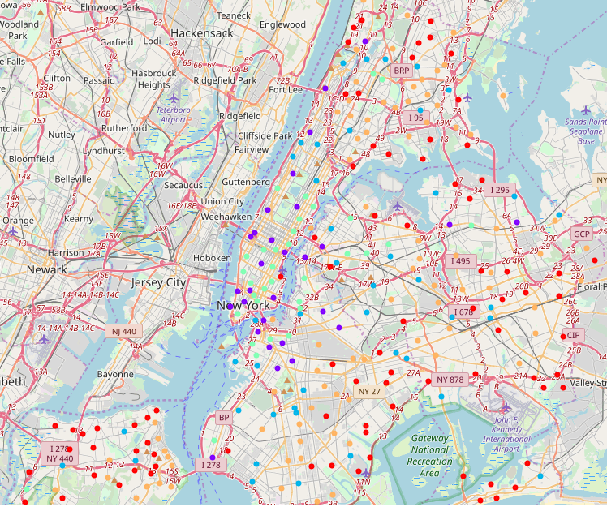
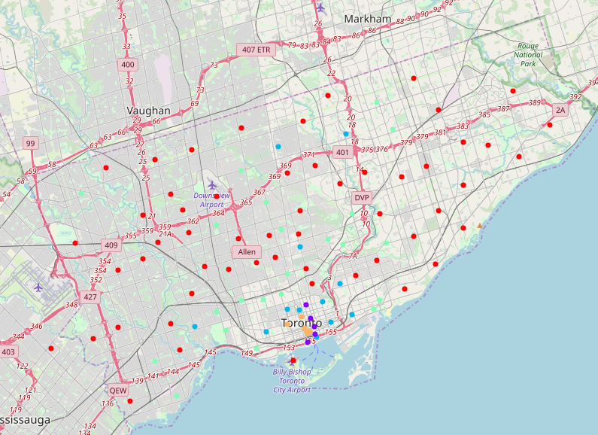
Data and methodology
Using main venues and one-hot encoding to convert sub venues to numerical values
Using K-means clustering method to divide the numerical representation of neighborhoods into 5 different clusters
Using calculate the pairwise correlation of neighborhoods between two cities.
New York cluster map
Toronto cluster map

Slide 7
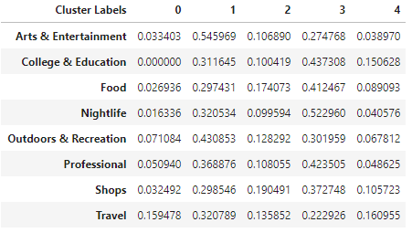
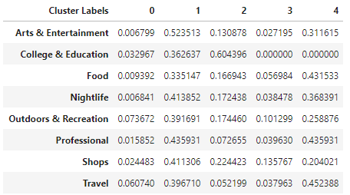
Results and Discussion
Clustering result:
The clustering in the previous map is quite meaningful. For example, the blue are in New York are prosperous tourist and with lost of entertainment, foods and etc. The blue area (same cluster) in Toronto are also the similar commercial area.
K-mean numerical result:
Scaled New York cluster vectors
Scaled Toronto cluster vectors

Slide 8
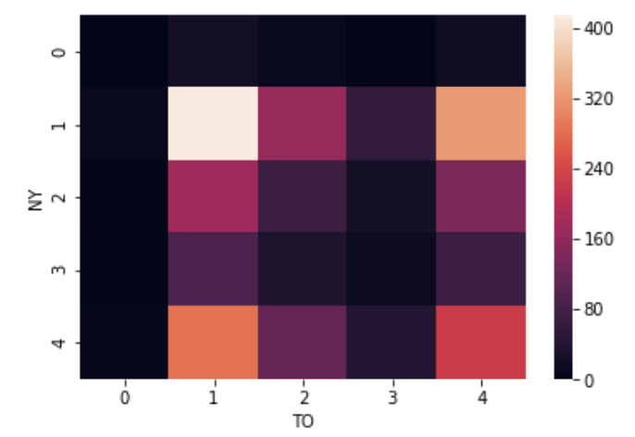
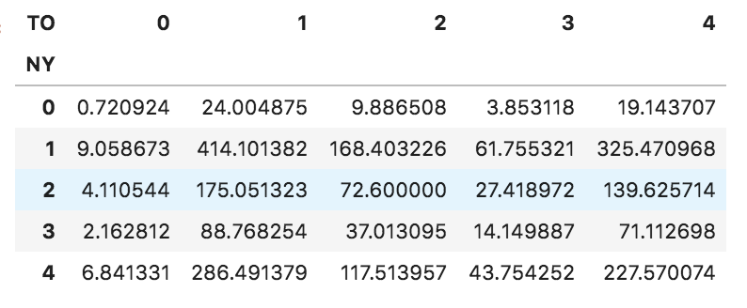
Results and Discussion
Pairwise correlation table obtained using the cluster vector.
From the correlation table and map (left and right below), we can see that cluster in NY [0, 1, 2, 3, 4] is mapped to [[0, 4], 1, 3, 2, 0] in Toronto.
Pairwise correlation heatmap
Pairwise correlation table

Slide 9
Summary
New York has 5 boroughs and 306 neighborhoods.
Toronto has 11 boroughs and 103 neighborhoods.
New York and Toronto can be divided to 5 cluster area with distinct venues differences.
New York cluster 1 and 4 is most prosperous area and both mainly located in Manhattan
Toronto cluster 1 and 4 is also most prosperous area and both mainly located in financial district near the water in Toronto. Cluster 0 in both cities are the perimeter zone. Cluster 2 and 3 are local commercial areas.

